Slide 1

Web ETP session 2 : JavaScript Introduction And Fundamentals
Members :
Jiya Rathod
Simran Agrawal
Ojas Manchanda

Slide 2
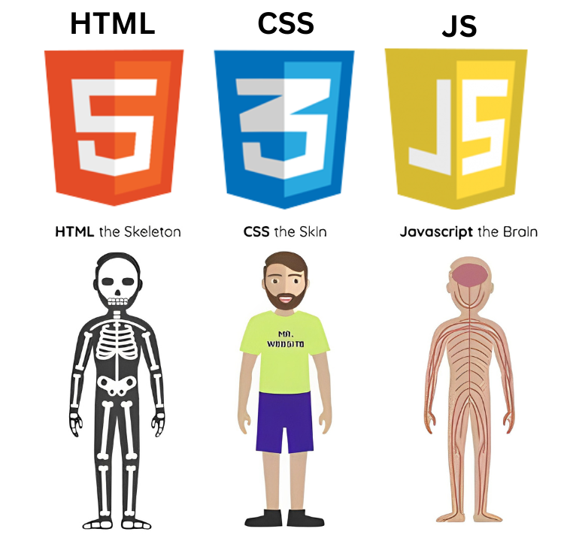

Slide 3
What is JavaScript?
JavaScript (JS) is a cross-platform , object-oriented scripting language used to make webpages interactive.
Example: Buttons that respond when you click, complex animations , etc.
Without JavaScript → websites would just be plain text and images (like a newspaper).
With JavaScript → websites become dynamic and alive (like YouTube, Instagram, Gmail).
JavaScript is case-sensitive language unlike HTML (IDs in HTML are case-sensitive).

Slide 4
Where does JavaScript run?
JavaScript can run in two main places:
In the Browser (Frontend)
Every web browser (like Chrome) has a built-in JavaScript Engine (for Chrome it's called V8).
That’s how JS runs directly in your browser when you open a website.
Example: When you click a "Like" button on Instagram, JS in your browser updates the counter without reloading the page.
On the Server (Backend)
With the help of Node.js (a runtime environment), JavaScript can run on servers too.
That means JS is not only for the browser — it can also handle things like databases, APIs, and server logic.
Example: Netflix, PayPal, LinkedIn use Node.js for their backend.

Slide 5
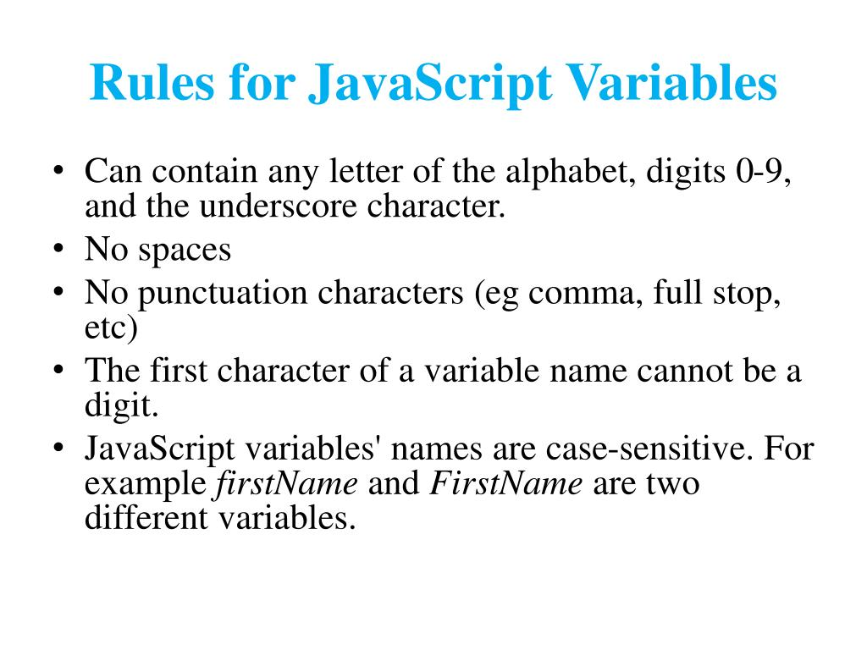

Slide 6
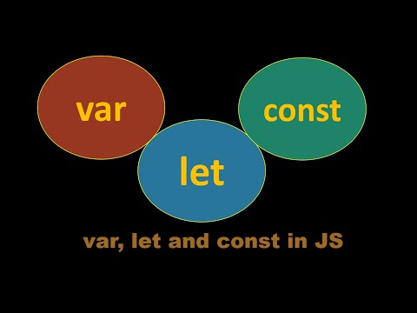
How to declare a variable?
There are three ways :

Slide 7
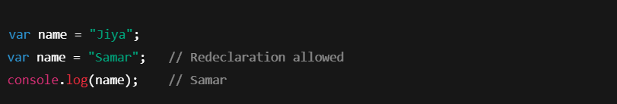
Introduced in old JavaScript (ES5).
Function scoped → accessible inside the function where declared.
Can be redeclared and updated.
Problem: Can cause bugs because it doesn’t respect block { } scope.
var:

Slide 8
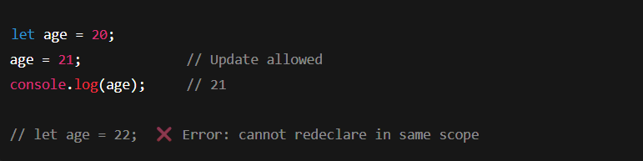
Introduced in ES6 (modern JS).
Block scoped → works only inside { }.
Can be updated, but not redeclared in the same scope.
Safer than var.
let:

Slide 9
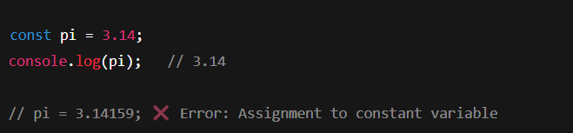
Also introduced in ES6.
Block scoped (like let).
Cannot be updated or redeclared → value is fixed.
Good for constants (like PI, URL).
const:

Slide 10
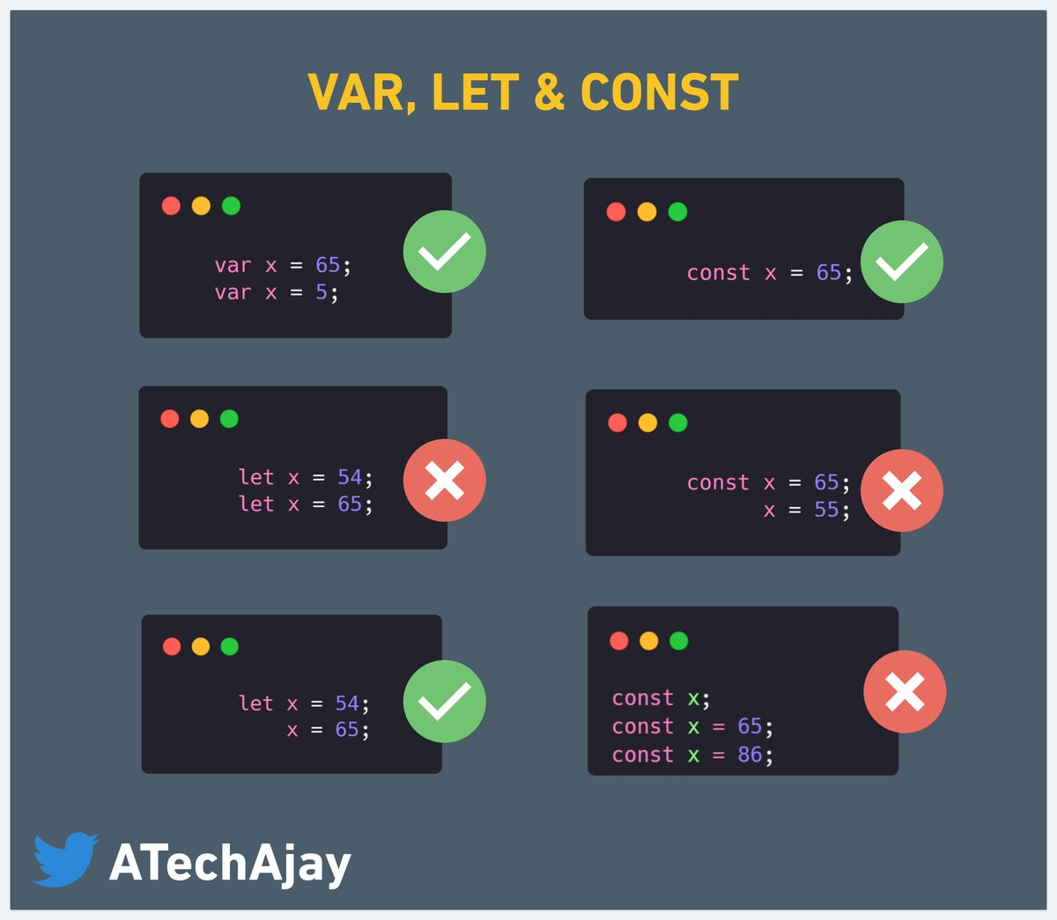

Slide 11
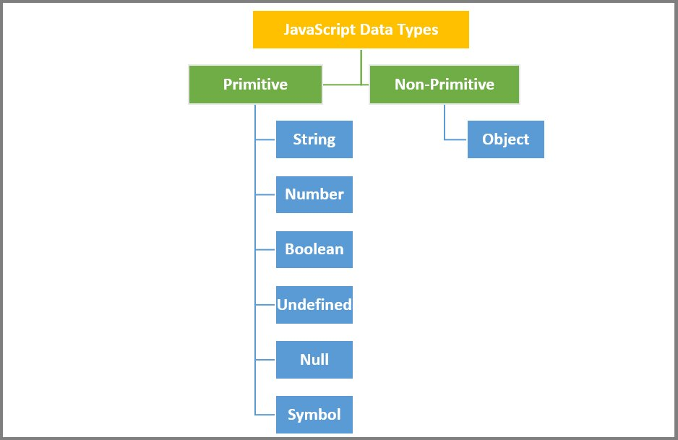

Slide 12
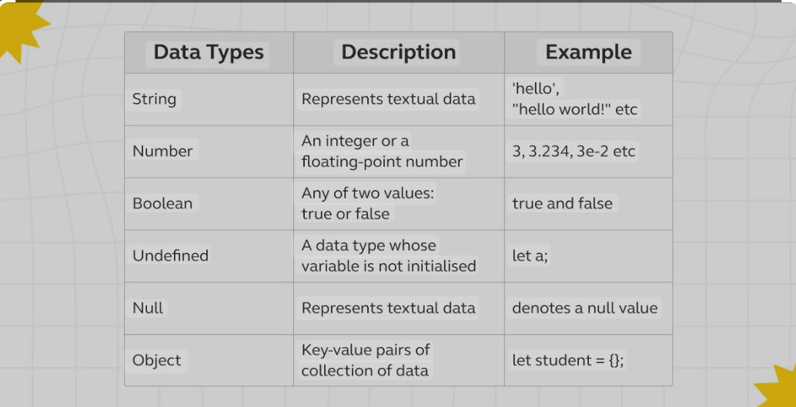

Slide 13
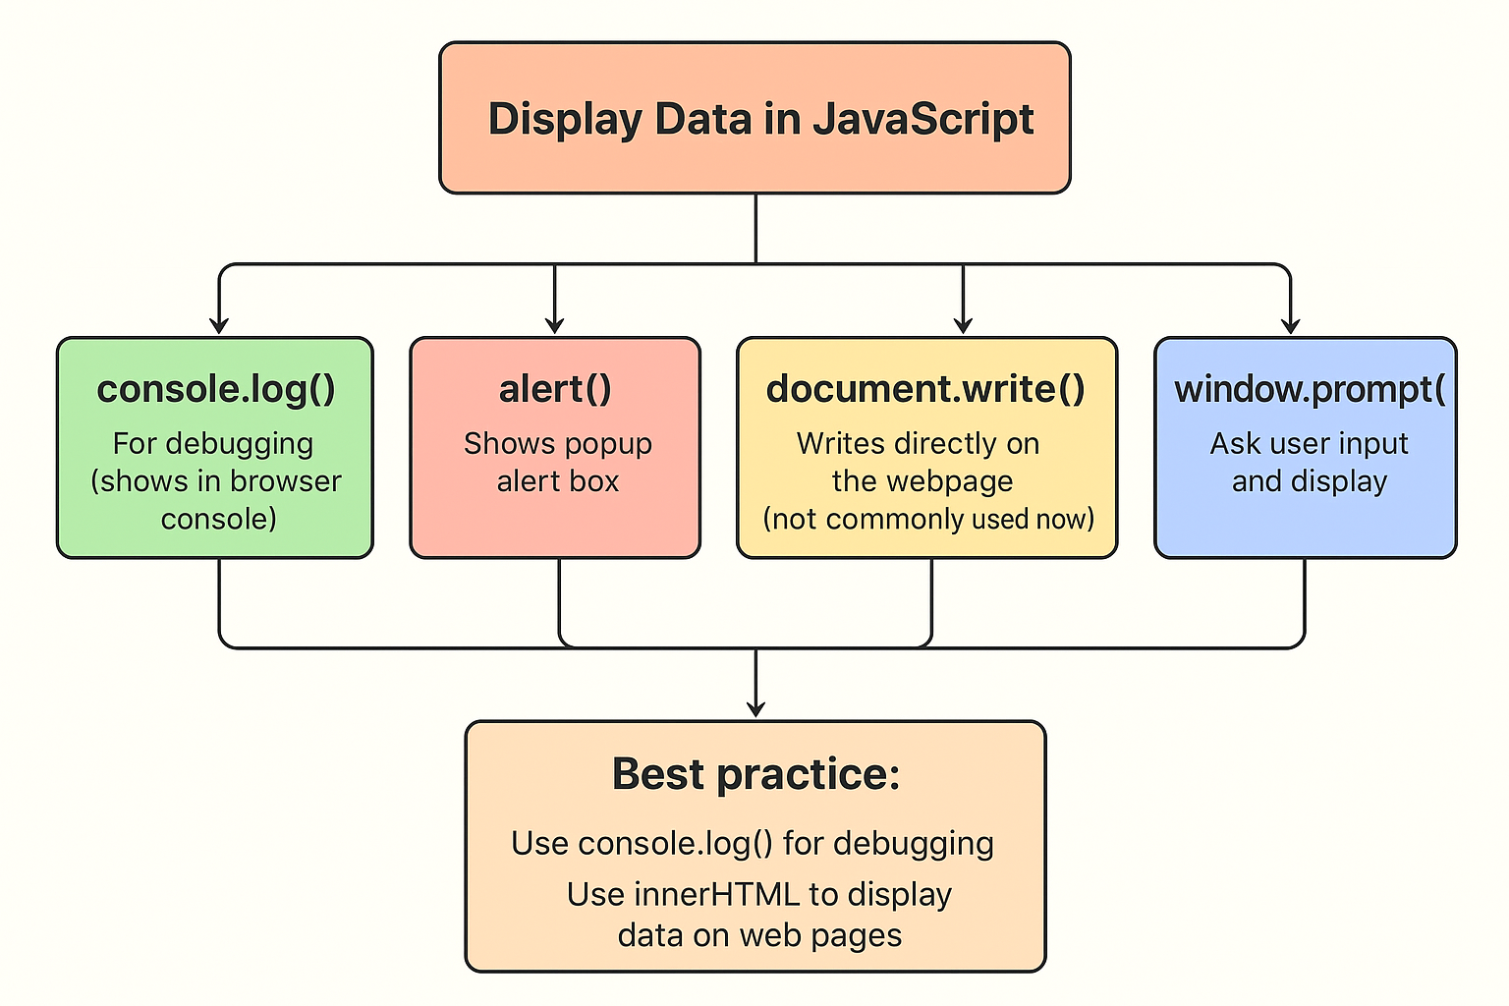

Slide 14
JavaScript can be added in HTML using <script> tag
either internally or externally.
External JS file :
External scripts cannot contain <script> tags.
You can place an external script reference in <head> or <body> of html file.
Example: <script src=“first.js”></script>

Slide 15
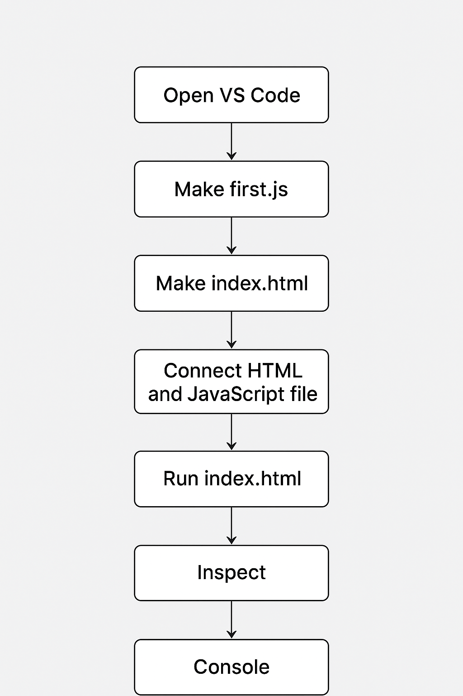
How will we run our external JavaScript code?

Slide 16
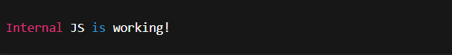
Internal JavaScript :
<!DOCTYPE html>
<html>
<head>
<title>Internal JavaScript Example</title>
</head>
<body>
<h1>Hello World</h1>
<p id="demo"></p>
<!-- Internal JavaScript -->
<script>
document.getElementById("demo").innerHTML = "This text is added using internal JavaScript!";
console.log("Internal JS is working!");
</script>
</body>
</html>

Slide 17
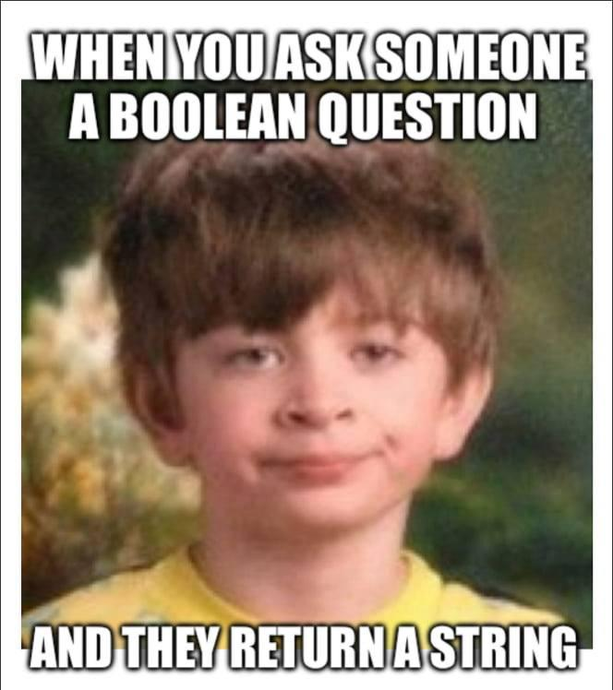
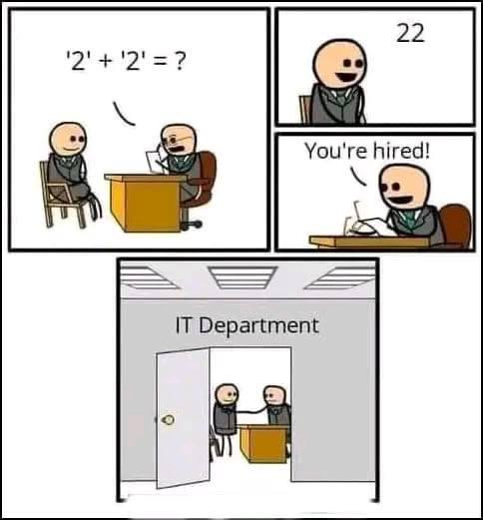
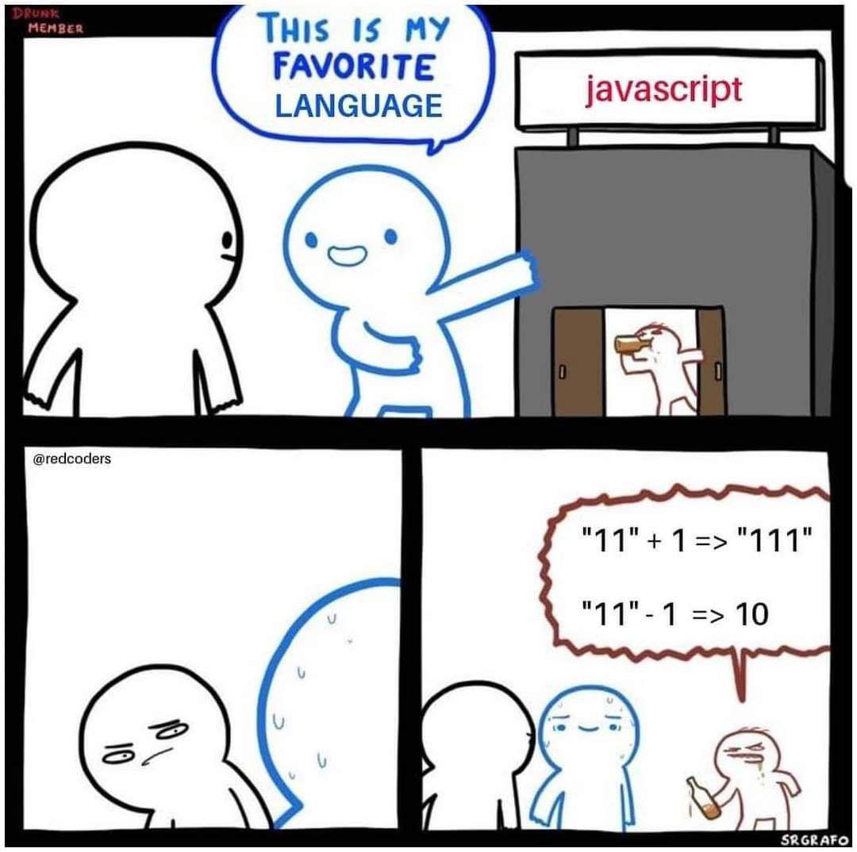
Type coercion and type conversion

Slide 18
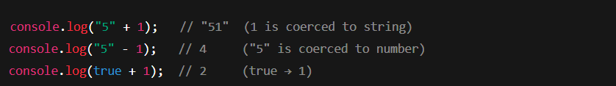
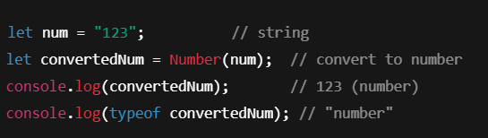
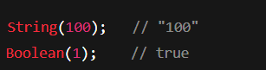
1. Type Coercion
When JavaScript automatically converts data types in the background to make an operation work. This happens implicitly.
2. Type Conversion (Type Casting)
When you manually convert one data type into another. You, the developer, tell JavaScript to change the type.

Slide 19
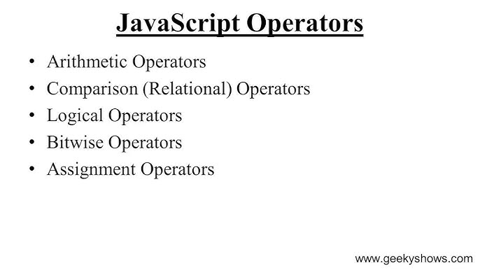

Slide 20
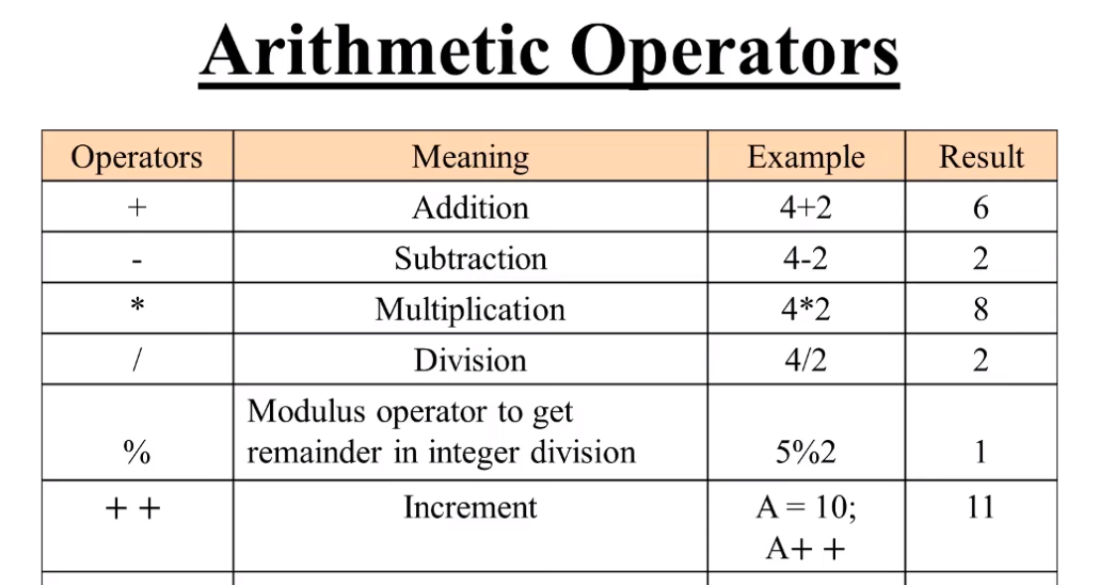

Slide 21
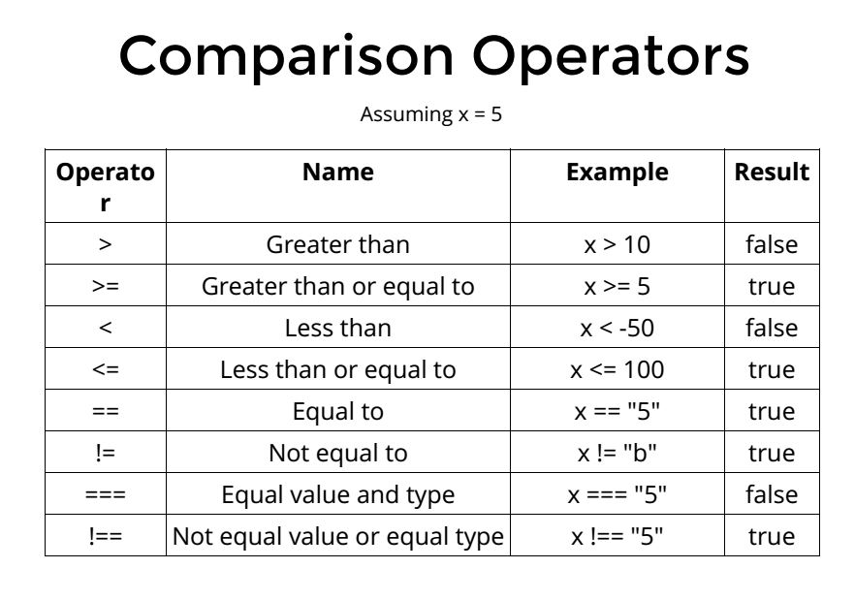

Slide 22
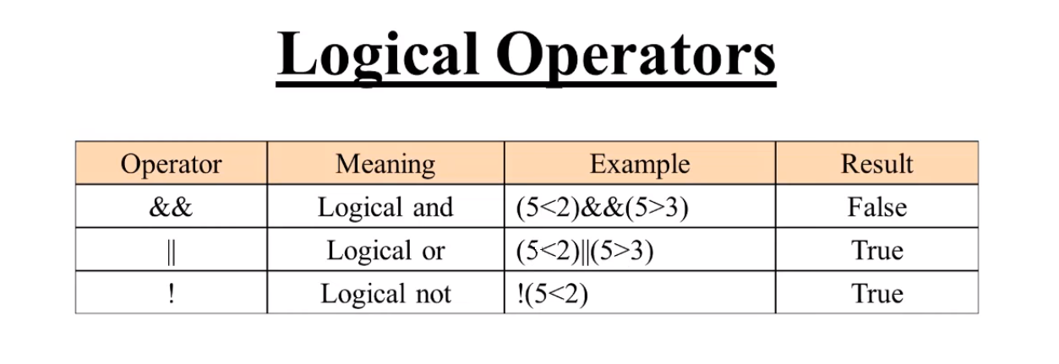

Slide 23
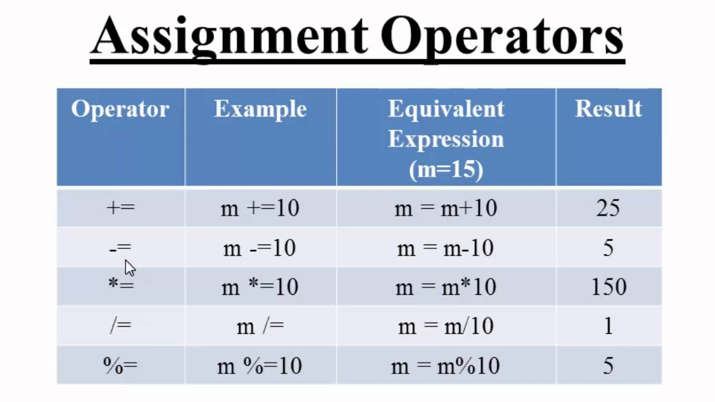

Slide 24
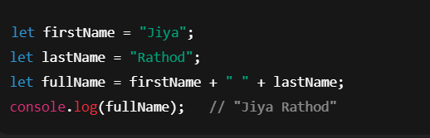
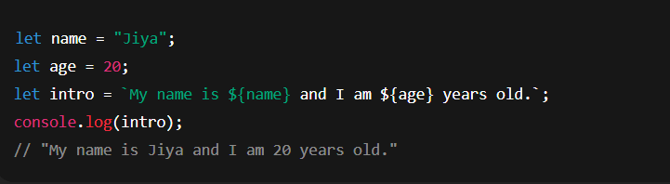
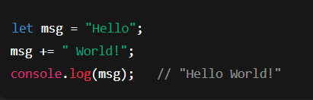
String Operators
1. Concatenation Operator (+)
Used to join two or more strings
3. Template Literals (with ${})
A modern way (ES6) to combine strings using backticks. Easier than + operator.
2. Concatenation Assignment Operator (+=)
Appends one string to another.

Slide 25
1. Control Flow (Intro)
Definition: Control flow is the order in which individual statements, instructions, or function calls are executed in a program.
Why Important? It allows us to make decisions (if/else), repeat tasks (loops), and create dynamic behavior.
Types of Control Flow Statements:
Conditional Statements → if, if-else, else if, switch
Loops → for, while, do-while
✨ Example in real life: 👉 If it’s raining → take an umbrella, else → wear sunglasses.

Slide 26
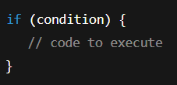
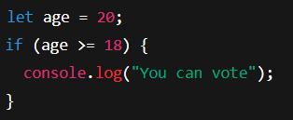
1. If Statement
Definition: Executes a block of code only if a condition is true.
Syntax:
Example:

Slide 27
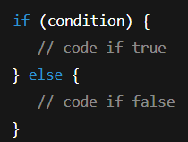
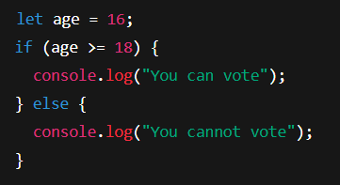
2. If–Else Statement
Definition: Executes one block if condition is true, otherwise executes the other block.
Syntax:
Example:

Slide 28
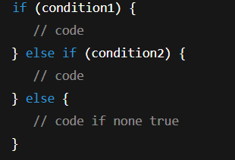
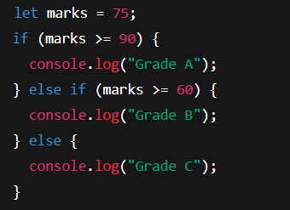
3. Else If Statement
Definition: Used to test multiple conditions.
Syntax:
Example:

Slide 29
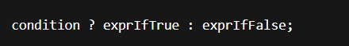
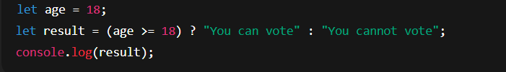
4. Ternary Operator
Definition: A shorthand if–else statement.
Syntax:
Example:

Slide 30
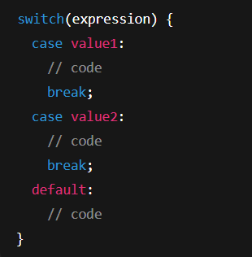
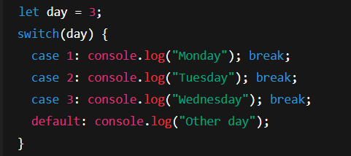
5. Switch Statement
Definition: Used for multiple choices, cleaner than many else if.
Syntax:
Example:

Slide 31
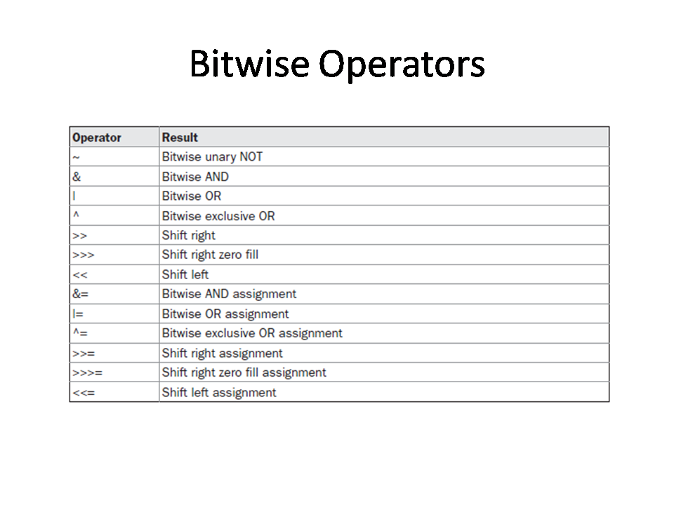

Slide 32
Loops
A loop is a programming construct that allows us to repeat a block of code multiple times.
Instead of writing the same code again and again, we use loops to make programs shorter, efficient, and easier to manage.
Loops are commonly used for:
Repeating tasks
Iterating through data
Automating repetitive processes
Key Idea: “Write once, execute multiple times.”

Slide 33
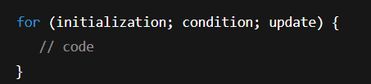
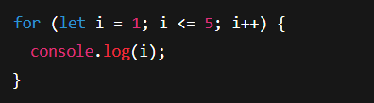
6. For Loop
Definition: Repeats code for a fixed number of times.
Syntax:
Example:

Slide 34
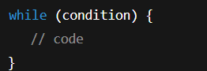
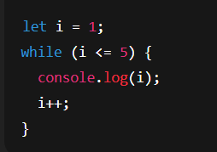
7. While Loop
Definition: Repeats code while a condition is true.
Syntax:
Example:

Slide 35
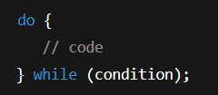
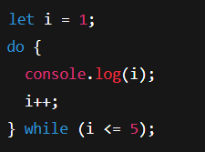
8. Do–While Loop
Definition: Like while, but runs at least once before checking condition.
Syntax:
Example:

Slide 36
Functions (Intro)
. Definition: A function is a block of reusable code designed to perform a specific task.
Why Use Functions?
Avoid code repetition
Improve readability
Easier debugging and modular programming
Parts of a Function:
Function name
Parameters (inputs)
Function body (code)
Return value (output)
Types of Functions:
Function Declarations
Function Expressions
Arrow Functions
Anonymous Functions
✨ Real-life example: 👉 Instead of writing steps to make tea again & again, just call makeTea() when needed.

Slide 37
Parts of a Function
A function in JavaScript is made up of several components:
Function Name 🏷️
Identifier used to call the function.
Example: greet in function greet() {}
Parameters 📥
Inputs that a function accepts.
Works like variables inside the function.
Example: (name) in function greet(name) {}
Function Body 🧩
The block of code inside { } that runs when the function is called.
Example:
{
console.log("Hello " + name);
}
Return Statement 📤
Specifies the value the function sends back after execution.
If no return is given, the function returns undefined.
Example:
return "Hello " + name;

Slide 38
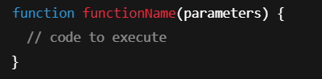
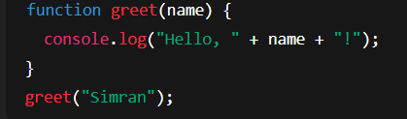
1. Function Declarations
Definition: A standard way to define a function that can be called anywhere in the code due to hoisting.
Syntax:
Example:

Slide 39
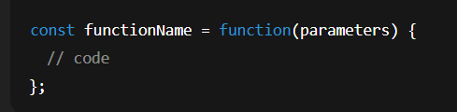
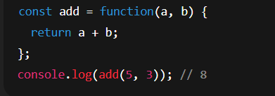
Function Expressions
Definition: A function stored inside a variable. Unlike declarations, they are not hoisted.
Syntax:
Example:

Slide 40
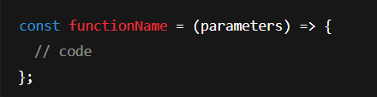
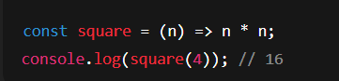
3. Arrow Functions
Definition: A shorter syntax for writing functions, introduced in ES6. They do not bind their own this.
Syntax:
Example:
Extra Point: Arrow functions are best for callbacks (like in map, filter, forEach).

Slide 41
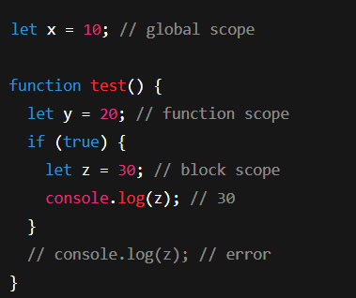
4. Scope
Definition: Scope determines the accessibility of variables.
Types:
Global Scope: Variables declared outside functions (accessible everywhere).
Local/Function Scope: Variables declared inside a function.
Block Scope (let/const): Variables inside {} are only accessible inside that block.
Example:

Slide 42

5. Hoisting
Definition: JavaScript moves declarations to the top of their scope before execution.
Key Point:
Function declarations are hoisted completely.
Variables declared with var are hoisted (but undefined).
let and const are hoisted but remain in a temporal dead zone.
Example:

Slide 43

6. Closures (Intro)
Definition: A closure is created when an inner function "remembers" variables from its outer function even after the outer function has finished executing.
Why Important: Helps in data privacy and function factories.
Example:

Slide 44
Objects, Arrays & Methods
MM/DD/20XX

Slide 45

Objects
An object is a collection of properties.
A property is a key-value pair.
A method is a function stored as a property.

Slide 46


Objects Creation
METHOD 1 : Object Literals
METHOD 2 : newObject()

Slide 47

Object Properties & Methods
Accessing Properties → done using dot notation (object.property) or bracket notation (object["property"]).
Adding Properties → new properties can be added at any time after object creation.
Updating Properties → existing properties can be reassigned new values.
Deleting Properties → properties can be removed using the delete operator.

Slide 48

The “this” Keyword
“This” is a special keyword in JavaScript.
It refers to the object that is currently executing the code.
Its value is determined by how a function is called, not where it is defined.

Slide 49

“This” Example

Slide 50
Array operations
An array is a special type of object in JavaScript used to store multiple values in a single variable.
Values in an array are ordered and can be accessed by their index (starting from 0).

Slide 51
Properties & Methods of Array(I)
A. Adding/Removing Elements
Add at the end → push
Remove from the end → pop
Add at the beginning → unshift
Remove from the beginning → shift
B. Accessing and Modifying
Retrieve elements using index.
Update values by assigning to an index.

Slide 52

Properties & Methods of Array(II)
C. Iteration
Loop through elements using for, for…of, or higher-order methods.

Slide 53
Properties & Methods of Array(III)
map → transform each element → returns new array.
filter → select elements that match condition → returns new array.
reduce → combine all elements → returns single value.
find → return first matching element → returns one value (or undefined).
sort → arrange elements → modifies the original array.

Slide 54

Destructing Operator (...)
• Destructuring allows extracting values from arrays or objects into separate variables.
Makes code shorter and more readable.

Slide 55

Spreading Operator (...)
Expands an array or object into individual elements.
Useful for copying, merging, or passing elements as arguments.

Slide 56

Rest Operator (...)
Collects remaining elements into an array.
Used in function parameters or array destructuring.

Slide 57

THANK YOU

